Slide 1
Agile Presentation
Southern New Hampshire University
CS – 250 7-1 Presentation
Bradly Van Hoorebeke
8/13/2023

Slide 2
Agile Team Roles
Scrum Master:
Facilitates Scrum events, removes obstacles.
Champions agile principles and fosters collaboration.
Guides the team towards continuous improvement.
Product Owner:
Prioritizes and manages the product backlog.
Represents stakeholders and aligns with business goals.
Ensures high-value features are developed.
Testers:
Plan and execute testing strategies.
Ensure product quality and identify defects.
Provide valuable feedback to developers.
Developers
Design, code, and test software functionality.
Collaborate to achieve sprint goals.
Deliver functional product increments.

Slide 3
Navigating SDLC Phase in Agile Approach
Backlog Creation:
Identify and prioritize user stories based on business value.
Importance: Lays the foundation by aligning development goals with business needs. Prioritization ensures efficient resource utilization.
Sprint Planning:
Select user stories for the upcoming sprint.
Break stories into tasks and estimate effort.
Importance: Defines the sprint's scope, sets clear goals, and creates a roadmap for execution.
Sprint Execution:
Developers code, testers validate.
Collaborate to deliver functional product increments.
Importance: Achieves incremental progress, promotes continuous integration, and offers early visibility of functionality.
Daily Standups:
Short daily meetings for progress updates.
Identify and address obstacles promptly.
Importance: Enhances team communication, coordination, and real-time issue resolution.
Sprint Review:
Present completed work to stakeholders for feedback.
Incorporate feedback for continuous improvement.
Importance: Validates the work, ensures alignment with customer expectations, and informs subsequent iterations.
Sprint Retrospective:
Reflect on the sprint's achievements, challenges.
Identify improvements for future iterations.
Importance: Drives continuous improvement, enhances team effectiveness, and supports learning from experiences.

Slide 4
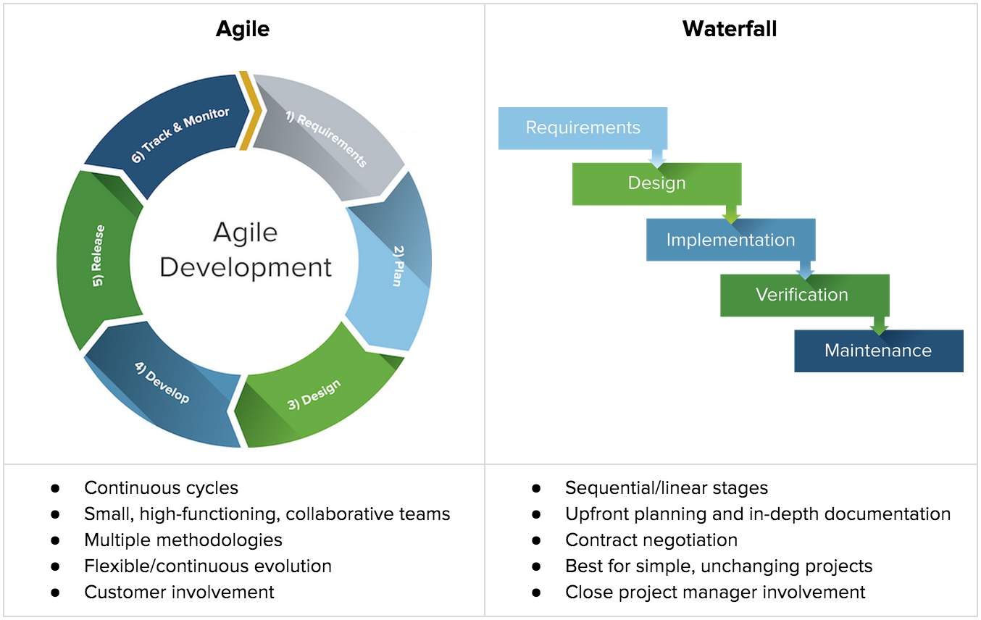
Waterfall and Agile

Slide 5
Contrasting Waterfall and Agile Approaches
Waterfall Approach:
Linear and sequential phases (Requirements, Design, Implementation, Testing).
Problem: Change in requirements would disrupt established flow.
Solution: Going back to earlier phases for adjustments, causing delays and increased costs.
Importance: Demonstrates the inflexibility of Waterfall when dealing with evolving requirements, leading to extended timelines.
Agile Approach:
Iterative and incremental sprints.
Problem: Change can be accommodated in upcoming sprints.
Solution: Incorporating changes in the next sprint, maintaining adaptability and minimizing disruption.
Importance: Highlights Agile's ability to respond quickly to changes, ensuring a smoother development process.
Key Contrast:
Waterfall: Rigid structure, changes are disruptive and costly.
Agile: Flexible framework, changes are manageable within short cycles.

Slide 6
Choosing Between Waterfall and Agile
Project Complexity:
Waterfall: Well-defined, stable projects.
Agile: Complex, evolving projects.
Course Experience: Our course project involved dynamic requirements that evolved over time. Agile's adaptability allowed us to accommodate changes efficiently.
Customer Involvement:
Waterfall: Limited customer involvement after initial requirements.
Agile: Continuous customer engagement.
Course Experience: Agile's iterative nature enabled us to incorporate frequent customer feedback, ensuring our final product met their expectations.
Adaptability:
Waterfall: Limited room for adjustments.
Agile: Emphasis on responding to changes.
Course Experience: Agile's iterative cycles allowed us to refine our approach based on insights gained during development, leading to better outcomes.
Predictability:
Waterfall: Offers predictability in timeline and scope.
Agile: Provides flexibility with some predictability trade-off.
Course Experience: Agile's iterative nature occasionally introduced variability, but it facilitated course correction for optimal results.
Time-to-Market:
Waterfall: Longer time to final product delivery.
Agile: Frequent releases deliver incremental value sooner.
Course Experience: Agile's phased approach allowed us to showcase working components earlier, enhancing stakeholder engagement.

Slide 7
References
Pal, S. K. (2019, September 9). Software engineering: Classical waterfall model. GeeksforGeeks. https://www.geeksforgeeks.org/software-engineering-classical-waterfall-model/
Schwaber, K., & Sutherland, J. (2020). The 2020 Scrum Guide. Scrum Guide | Scrum Guides. https://scrumguides.org/scrum-guide.html#scrum-events
Scrum Forum . Scrum.org. (n.d.). https://www.scrum.org/
West, D. (n.d.). Scrum - what it is, how it works, and why it's awesome. Atlassian. https://www.atlassian.com/agile/scrum

